Slide 1

Career Planning and
Career Management
Believe. Belong. Become.
Dr. J. Balamurugan

Slide 2

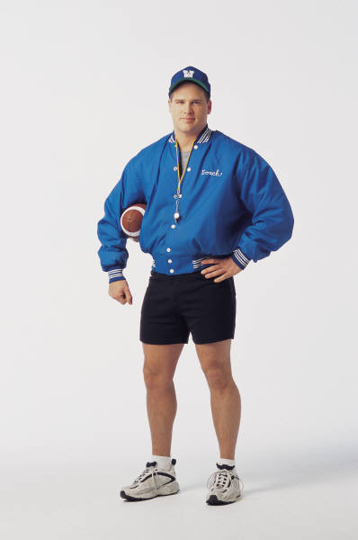




What do you want to be?
Teacher, Minister, Doctor, Real Estate, Computer Programmer, Banker, Coach, Accountant, Lawyer, etc.
Fashion Designer
Civil Servant
Economist
Engineer

Slide 3




What do we want
Respect in society
Money
Fame
Satisfaction
Security
Happiness and Joy
Notes:
Why we select career

Slide 4

What leads to lack of career success?
Career not matching with one’s interest
Career not matching with one’s potential
Career not matching with one’s personality

Slide 5

Why does one go for a career that’s not a good match?
Opportunity perceptions
Opportunity Perception
Parental influence
“This is a growing field, many opportunities”
“This will ensure a good job”
“I have read that it is a very good career”
Parental Influence
“My Dad is an engineer”
“My sister has done biotechnology and she has told me about it ”
“My brother is also an engineer and I also want to do it”

Slide 6

Peer Pressure
Peer pressure
Parental pressure
Lack of knowledge or information
Lack of resources
Wrong perceptions
“My friends would go for this”
“All of my friends will prepare for MBBS”
Parental pressures
“My Parents say I should go for MBBS”
“My Parents want me to take care of the business”

Slide 7
WRONG PERCEPTIONS ABOUT EXPLORING CAREERS
Looking only at 2-3 careers…
Limited awareness of other avenues
Perception about those 2-3 careers
  There is more opportunity in this career
  There is more status & prestige in this career - Social acceptability
Apprehension to try new things

Slide 8

The Need of the Hour….
Effective Career Management.
which should be a:
        Systematic approach
        Objective
        Individualized

Slide 9
CAREER MANAGEMENT
“The Three step Mantra”

Slide 10

CAREER MANAGEMENT
Know yourself
Career Awareness
Take ACTION

Slide 11

Know yourself…
What should one know about oneself?

Slide 12


Know Yourself…
Identification of
  Interests
  Inclinations
  Talent
  Skills
  Strengths
  Areas to improve upon
  Personal Characteristics
How?
  Inputs from friends, family
  Hobbies
  Extra-curricular activities
  Career assessment program

Slide 13



Examples of interests & talents
Reading
Communication
Painting
Listening
Sports
Dancing
Singing

Slide 14
Understanding Yourself
What is the kind of work I like to do?
What activities give me the most satisfaction?
What is the environment in which I would like to work?
What kind of people do I like to work with?
What kind of abilities do I want to build on?

Slide 15

Pointers for Exploring Careers… (awareness)
How?
  Reading
  Surfing
  Career Talks
  Seminars
  Career Exhibition
  Career Guidance
Know more about the career of your choice
  Nature of work
  Work roles
  Emerging trends
  Career path / Steady route
  Prospects
  Related careers/ back-up options
Notes:
Before join the job we have to check….

Slide 16
You may be tempted to have your son or daughter major in a particular field because it’s “hot” and the job prospects and earning potential are very high.
Reality – the career is hot for you if you have the required interest, potential & the personality to meet the requirements of the Career
Do we know there are 150+ possible career options today?

Slide 17

What aptitude is
Shakuntala Devi gifted with?
Manish Malhotra is gifted
with this talent

Slide 18

Shakuntala Devi is gifted with Numerical aptitude
Manish Malhotra is a Successful Designers are gifted with good observation & visualization ability
Every professional who is successful in a certain career, possesses certain aptitudes that increases their effectiveness

Slide 19
Some Career Options
Engineering
Architecture
Medicine
Para-medicine
Pharmacy
Nursing
Biological Sciences
Physical Sciences

Slide 20
Some Career Options
Merchant Navy
Defense
Commercial Pilot
Product Designing

Slide 21
Some Career Options
Psychology
Economics
Languages
Social Work
Chartered Accountancy
Company Secretaryship
Cost Accountancy

Slide 22
Some Career Options
Management
Journalism
Advertising
Fashion Designing
Commercial Art
Hotel Management
Law
Civil Services

Slide 23
Offbeat Careers
Nutrition & Dietitics
Broadcast Journalism
Fitness Training
Animation
Game Designing
Instructional Designing
Merchandising
Cinematography
RJ, VJ
Training

Slide 24


Taking Action…
Which career is most suited
Best route to reach there
Develop important skills needed
Develop the right attitude for Success

Slide 25
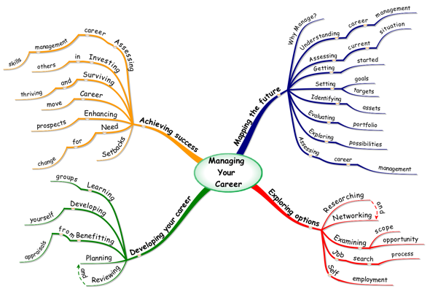

Slide 26

Thank You
And good luck!

